Slide 1
Fortify
Matchmaking tool for experience

Slide 2

Who r we?
Fortify is a non-for-profit online platform which aims to bridge between underrepresented organizations and volunteering experts who will provide industry-standard cybersecurity services. Fortify works together with graduates and other IT professionals looking to build a stronger digital infrastructure for clients. By doing so, we create a range of employability opportunities and a resilient digital community.

Slide 3
PRIMARY GOALS
OUR VISION - A world where we can use whitehat volunteers to combat cybercriminals.
OUR MISSION - To ensure small organisations become more aware about their online responsibilities and are given access to relevant services and/or knowledge.
OUR AIMS
To provided well-equipped volunteers to the clients needs.
To help victims recover, mange, store and respond to any cybercrimes.
To provide industry-grade cybersecurity services as a non-for-profit org.
To communicate through effective training and services how ones organisation can safeguard itself.

Slide 4




We understand!
For those seeking employment in the cyber security industry, a lack of formal work experience can be a significant barrier to entry. Volunteering with Fortify as either a junior or a senior consultant helps you by providing invaluable hands-on work experience.
We discovered that almost more than 90% of our survey participants believed that volunteering would be a great gateway to expanding their industry experience all while being able to make a positive social impact on the community.

Slide 5
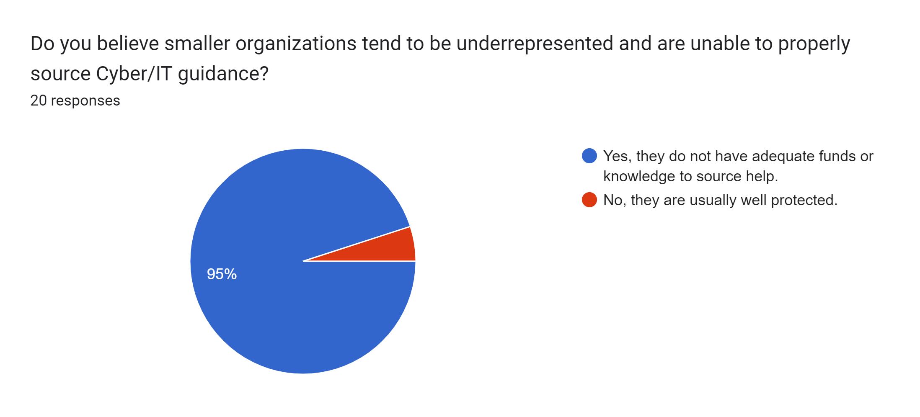
Why volunteer?
We do the sourcing for you!

Slide 6


Who can help?
Are you a graduate, a self-educate IT Professional or even a student? Well, you can STILL be part of the team! We value all years of experience & skills. Register today at WWW.FORTIFY.COM.AU

Slide 7
Start where you are. Use what you have. DO WHAT YOU CAN.
“
”
Arthur Ashe

Slide 8
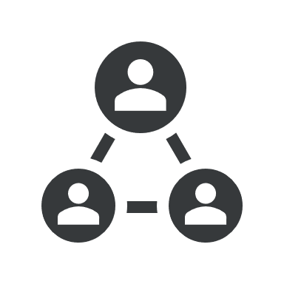


Where it all begins
1. We Assess
2.You register
3. we connect you
We asses small organizations in the community using a specificized framework.
We extract their common threats, weakness and strengths.
Now we have a potential client to handover to YOU.
We evaluate your skills using our scoring matrix to highlight if you would be the right volunteer.
You familiarize yourself with the tasks that need to be complete.
You give your feedback and chose if you would like to continue with the selected client.
We summarize your feedback and all queries.
We continue all communication with client.
Then we finally connect you. The matchmaking process ends here!

Slide 9

Be involved
At Fortify we believe all organizations should be given the opportunity to understand their online responsibilities and to have access to proper cyber security services. Be part of the change and register today @ www.fortify.com.au

